Slide 1
AGILE MODEL
quick or adaptable
Agile is based on the adaptive software development methods, whereas the traditional SDLC models like the waterfall model is based on a predictive approach
tasks are divided to time boxes (small time frames) to deliver specific features for a release. – iterations
Need for Agile Model
Demo over documentation − Demo working software is considered the best means of communication with the customers to understand their requirements, instead of just depending on documentation.
Customer collaboration − As the requirements cannot be gathered completely in the beginning of the project due to various factors, continuous customer interaction is very important to get proper product requirements.
Responding to change − Agile Development is focused on quick responses to change and continuous development.
Suitable for fixed or changing requirements - Good model for environments that change steadily.
Delivers early partial working solutions.
Enables concurrent development and delivery within an overall planned context.
Easy to manage.
Gives flexibility to developers

Slide 2
Phases of Agile Methodology
Requirement Gathering: You must define the criteria at this step. You should describe the project’s business opportunities and estimate the time and effort required to complete it. You can assess technical and economic feasibility based on this information.
Design the requirement: Work with stakeholders to define requirements once you’ve defined the project. To demonstrate how new features function and how they will fit into your existing system, use a user flow diagram or a high-level UML diagram.
Develop/Iteration: The work begins once the team has defined the requirements. Designers and developers begin work on their projects, with the goal of releasing a functional product. The product will go through several stages of development before being released, thus it will have basic, rudimentary functionality. Ultimately, deploying a non-static product or service.
Test: This phase basically involves the testing team i.e. the Quality Assurance team checks the product’s performance and seeking for the bug during this phase.
Deployment: The team creates a product for the user’s work environment in this phase.
Review / Feedback: The final phase is to get feedback after the product has been released. This is where the team receives feedback on the product and works through it.

Slide 3
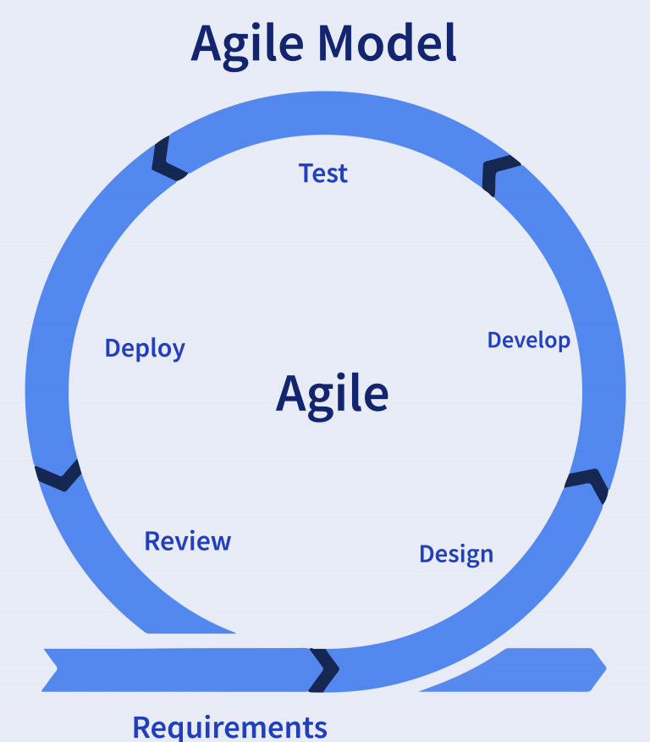
Agile Model might not be suitable for−
Not suitable for handling complex dependencies.
Depends heavily on customer interaction, so if customer is not clear, team can be driven in the wrong direction.
There is a very high individual dependency, since there is minimum documentation generated.
Transfer of technology to new team members may be quite challenging due to lack of documentation.

